Slide 1

Creating sub-domains

Slide 2
The elephant in the room…
What exactly is a domain?
Domain name is the address of your website that people type in the browser URL bar to visit your website.
In human words, if your website was a house, then your domain name will be its address.

Slide 3
IP addresses
The network recognise a host via an IP address.
E.g., 66.249.66.1
But it would be difficult for end users to type in a 12 digit number everytime we need to go to a website.
A domain name helps to solve that problem.

Slide 4

How to host a sub-domain?
Go to https://github.com/
Click “Sign up”

Slide 5
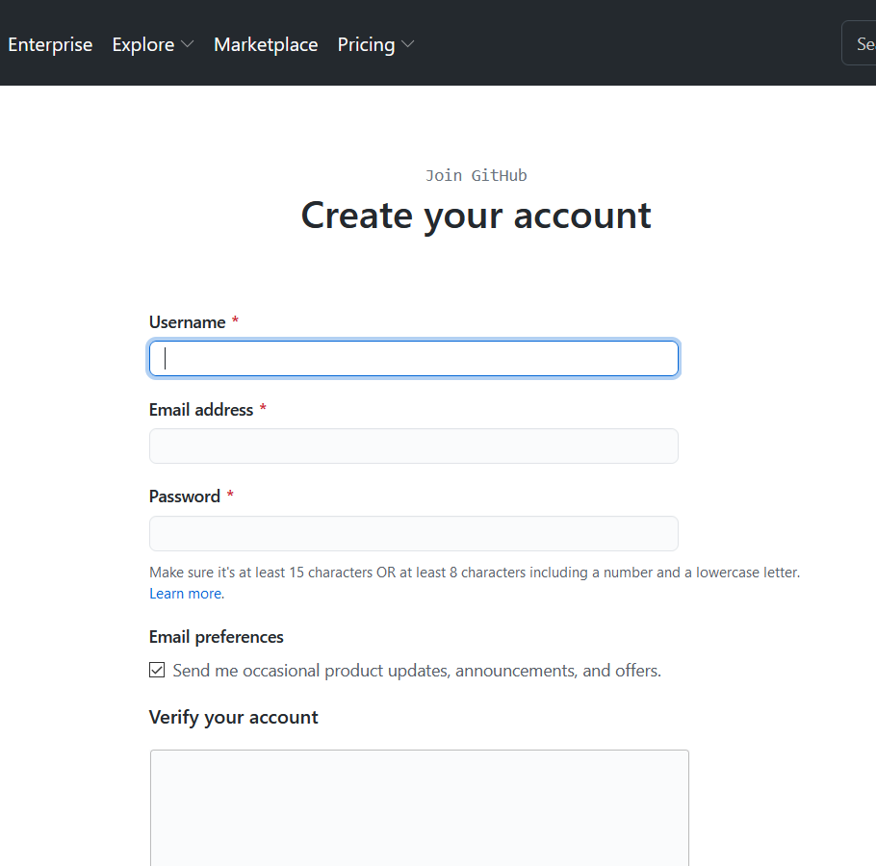
Create an account
Be sure that your username is unique!

Slide 6
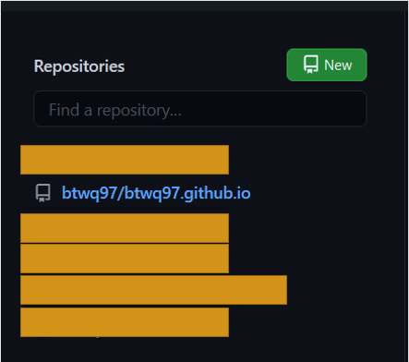
Once logged-in
Create a new repository by clicking on “New”.
Name it something related to your username.
For example, my username is btwq97. Hence, I’ll host my website a subdomain on Github as btwq97.github.io

Slide 7
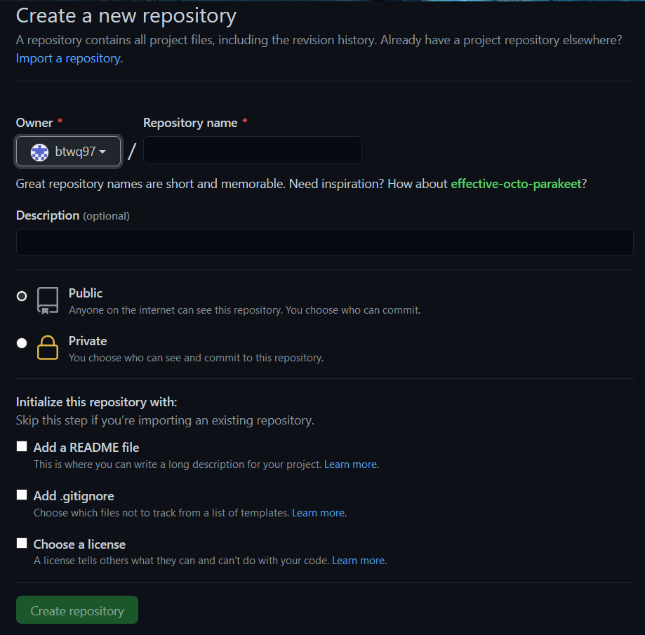
Creating a new repository
Just follow the instructions.
Make your repository public.
Some miscellaneous items:
README.md → a file that you add when you want to provide more information about project to other users.
.gitignore → when you add a filename in this file, the file will not be added to the remote server when you synchronise (technical term is ”push”).
License → choose whether other users could you your code to implement other stuff. It tells others what they can and cannot do with your code.

Slide 8
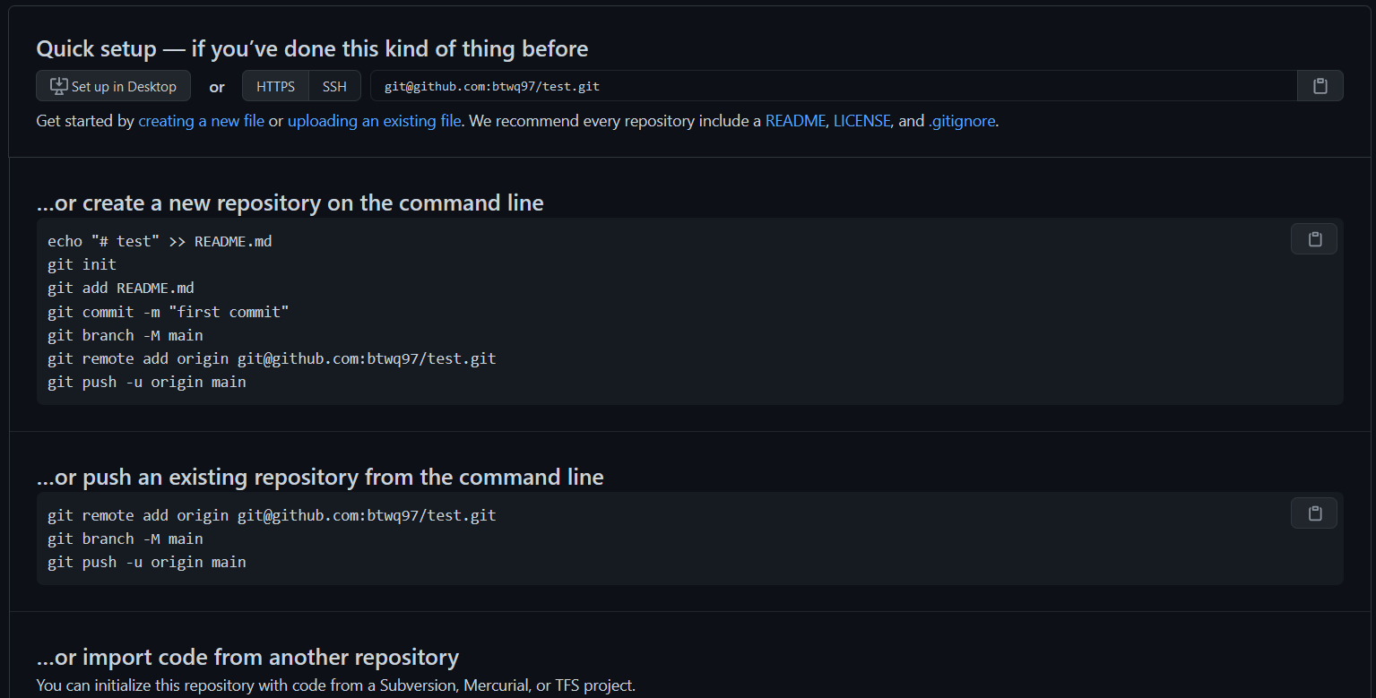
Uploading files

Slide 9
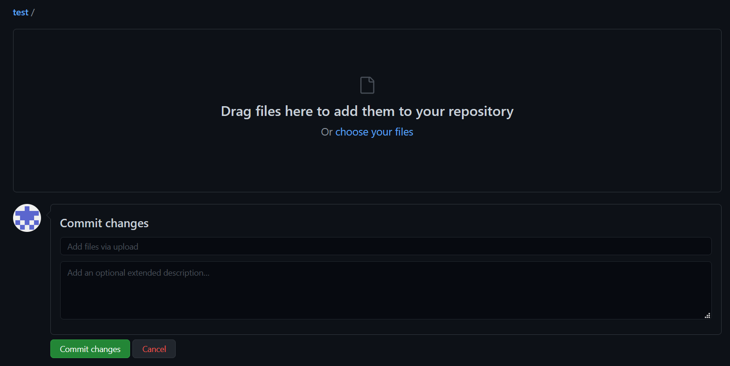
Uploading files
Please make sure that your file paths are correct.
Once checked, enter description then commit changes.
This is more of the UI upload, which is easier for beginners → there is a command line version which you may pick up on your own if interested.
Notes:
Uploading files to remote server

Slide 10
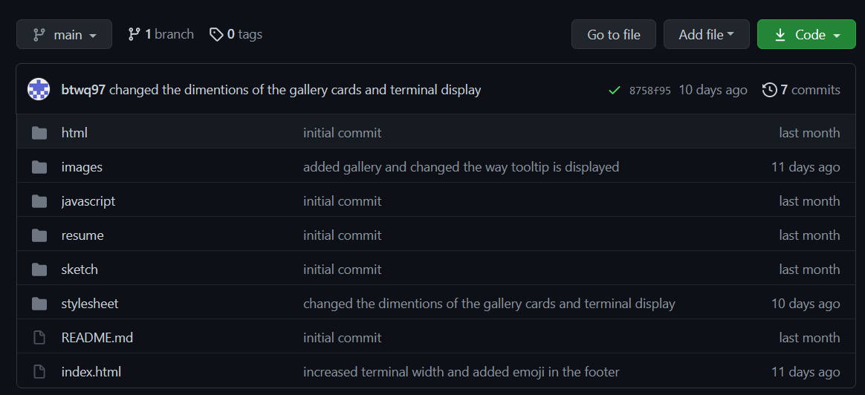
Website is LIVE
Notes:
Give it like max 15 mins before everything works.

